Slide 1
Notes:
I have been asked to speak to you this morning regarding the Women’s Council of REALTORS Big Picture! So, lets get started shall we??

Slide 2
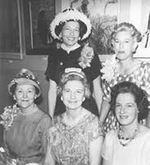
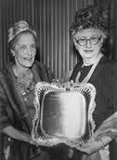
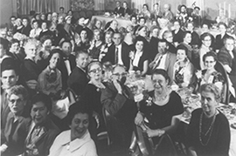
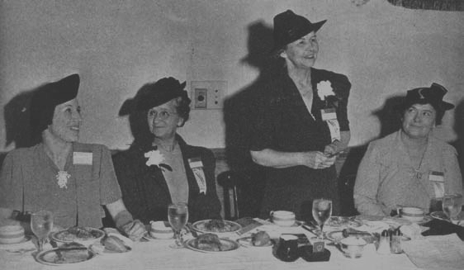
In 1938 the National Association of REALTORS® successfully encouraged the formation of the Women’s Council of REALTORS®.
The first convention was held November, 1938 in Milwaukee, Wisconsin. (Region II)
Attended by 37 ambitious women, representing 9 states.
Today, there are more than 250 chapters and 11,000 members
The Council is considered to have the most successful communication networks in the NAR family.
Notes:
We start with where it all started!
The actual birth of the Women’s Council of REALTORS was in 1938 in Milwaukee of all places!

Slide 3
One
Woman
Can Make A
Difference
But Together
We Can
Rock
The World
Notes:
READ slide…that is right…TOGETHER WE ARE UNSTOPPABLE. So, let’s get a little more specific!

Slide 4
Notes:
The Council has a very powerful Mission Statement.. READ SLIDE.
Join me in reading our Mission statement out-loud together. GREAT!
Take the time to memorize this statement. It really does an excellent job summarizing who were are and what our ultimate goal is.

Slide 5
L
Chapter Management Center
Find a Chapter
Chapter Business Planning
Leadership Development & Training
Marketing & Communications
Policies & Procedures
Programs
Recruiting & Retention
FAQ
2016 Academy Materials
Officer Invitation
Notes:
The rules of the game

Slide 6
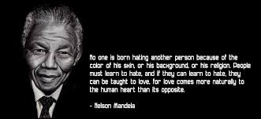
“Action without vision is only passing time,
vision without action is merely day dreaming,
but vision with action can change the world.”
~Nelson Mandela
Notes:
READ slide…Thank you Mr. Mandela…I could not have said it better myself!
Members of the Women’s Council of REALTORS are people in our industry with a vision that they put into ACTION!

Slide 7
Facilitate the professional growth and credibility of Council members as real estate experts in their marketplace.
We are a dynamic, accessible and diverse network, linking resources and member expertise to drive business success.
We identify, support and promote strong leaders in business, the Council, the industry and the community.
We promote the achievement and influence of women in real estate.
Notes:
So lets break down the Women’s Council of REALTORS Vision!
We are tasked with facilitating the professional growth….
We have got it together…dynamic, accessible, with a diverse network….
We encourage strong leaders…
Always promoting the achievements…

Slide 8
We are a magnet for career-focused REALTORS® with diverse backgrounds and a high level of professionalism.
We are sought after by other organizations as a source of leadership development and the businesswoman’s perspective.
We are a network of strong chapters that consistently deliver value and provide a collaborative, trusted, welcoming environment in which members can achieve their business goals.
We are a strong organization with the resources and infrastructure necessary to fulfill our mission and realize our vision.
Notes:
We are a magnet for….
Sought after by other organizations
Our Chapters are consistently delivering value and provide….
Do NOT underestimate us….we are a strong organization with…..

Slide 9
Professional Credibility
The Power of Relationships
Leadership
Diversity
Involvement
Success
Influence
Notes:
The Women’s Council of REALTORS CORE Values are spelled out in the Strategic Framework
Professional Credibility – we are career professionals committed to excellence
Power of Relationships – the Council provides and encourages an environment of collaboration. We believe when the members share their time, talent and experience the entire industry advances.
Leadership – every business, industry must have leaders. Members of the Womens Council of REALTORS develop and apply new found leadership skills and qualities.
Diversity – Our network is enriched through the celebration of and active outreach to the full diversity of our industry!
Involvement – Participation in the Women’s Council of REALTORS is the opportunity to contribute to change.
Success – Success brings credibility, influence and greater opportunity
Influence – Positive change comes from the inclusion of our perspectives not only in the real estate industry but the broader community!

Slide 10
Women’s Council Members
Local Chapter Presidents
State Governors and State Chapter Presidents
Regional Vice Presidents
Executive Committee
WCR Governing Board (plus Standing Committee Chairmen if they are not elected officers)
President
President-Elect
Recording Secretary
Financial Secretary
3 Immediate Past Presidents
WCR Representative
to NAR Executive Committee
3 Appointees
6 Elected
All Active Past National Presidents
Notes:
So here is the break down….
Everything….and I mean everything starts with the Members… Leaders are not leaders without followers or our members in this case!
Then we have our local Presidents
Followed by the State Governors (which we have two because of our growth in membership)
And the State President
Next up is the boss of the Region…. Insert your region information here …

Slide 11
Notes:
To quote Dr. Seuss….OH THE PLACES YOU’LL GO!

Slide 12
WCR State Spring Meeting, Lansing 5/6/16
Achieve/WCR State Meeting & Installation Dearborn – 1/20-22/16
WCR REALTOR Mid-Year meeting, Washington DC 5/12-14/16
WCR Region II Conference, Frankenmuth Probable June, 2016
WCR Fall Meeting, Michigan REALTOR® Conference,
Soaring Eagle Casino & Resort, Mt. Pleasant 10/5-7/16
WCR National Conference, Orlando Florida 11/2-6/16
Notes:
It is not all fun and games.
Insert all events in your area
Note that your networks are sending you to these different conferences. You will be expected to attend! There is plenty of time to sightsee…when the conference is in play…you DON’T play…you show up and participate!

Slide 13
Thank goodness!!
National Website:
www.wcr.org
Manage your local chapter website
Go to www.wcr.org – Sign in
Click – Chapter Tools
Click – Chapter Management Center
Edit your website
How to manage your chapter website
Notes:
Now, one of the really great things National has is the website. And each chapter gets their own chapter website. I have been on everyone of the chapter websites and this is something that we are not taking full advantage of.

Slide 14
Don’t
Forget!
Complete your Member Expertise Profile
Your profile allows you to capture your professional specialization and education.
Your profile is a form of personal advertising that will be used to determine a members area of expertise.
Upload your Color Photo
Referral Center
Search for members by areas of expertise in real estate, technology, marketing chapter management and more.
Available to members only.
Notes:
Now, when you are on the www.wcr.org. DON’T FORGET.
Complete your profile…talk yourself up…Upload a CURRENT picture. This is where members search for the perfect Women’s Council member to send referrals to. If your profile is not updated that referral could easily go to someone else.

Slide 15
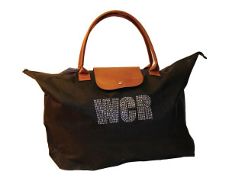
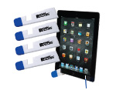
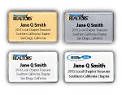
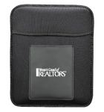
Home
:: Buy REALTOR® Logo Merchandise :: Buy IREM Logo
Copyright© Team Store 2014
Questions or comments? E-mail us, or call us at (847)991-4010. All pricing subject to change.
service@teamstore.com
847.991.4010
Questions?? Contact us at:
Notes:
We also have a cool online store!
Check it out….load up on the WCR products

Slide 16
Join the best in the business and open even more doors at Women’s Council by achieving your Performance Management Network (PMN) designation.
You have two option
Option A – Business Referral Track
Option B – Business Leadership Track
Don’t forget to check with National to see if “Fast Track” is available.
Notes:
Performance Management Network…aka PMN
A REALTOR family designation.
PMN is intensified Professional Performance Training
With 5 courses available as well as the possibility of some NAR designations! You have 2 options and even the possibility of a discount with Fast Track availability.

Slide 17
Notes:
As a final note…Everyone of you is going to have the opportunity to contribute to the council in a profound way…as well as influence members at the local, state and national level… so, READ slide!
Let the adventure begin!

